Slide 1


Is delay always
harmful to precision?
Nikolett Német*, Scott Parkins
University of Auckland,
The Dodd-Walls Centre for Photonic and Quantum Technologies
CLEO 10/06/16
*n.nemet@auckland.ac.nz

Slide 2

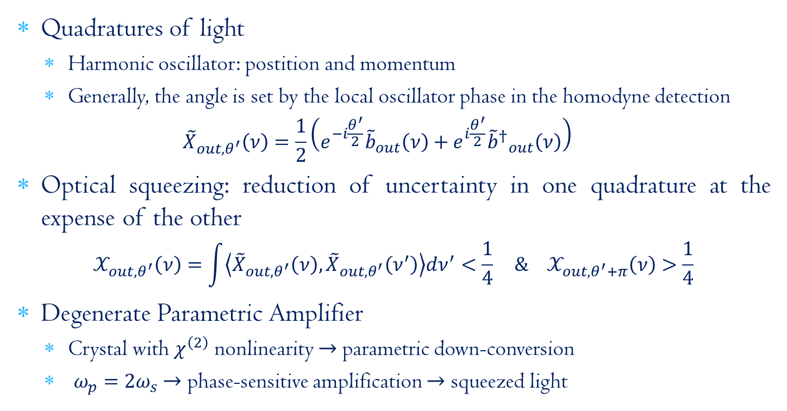
Optical squeezing & DPA
Quadratures of light
Harmonic oscillator: postition and momentum
Generally, the angle is set by the local oscillator phase in the homodyne detection
$${\tilde{X}}_{out,θ^{′}}\left(ν\right)=\frac{1}{2}\left(e^{−i\frac{θ^{′}}{2}}{\tilde{b}}_{out}\left(ν\right)+e^{i\frac{θ^{′}}{2}}{{\tilde{b}}^{†}}_{out}^{}\left(ν\right)\right)$$
Optical squeezing: reduction of uncertainty in one quadrature at the expense of the other
$$𝒳_{out,θ^{′}}\left(ν\right)=\int{\left\langle {\tilde{X}}_{out,θ^{′}}\left(ν\right),{\tilde{X}}_{out,θ^{′}}\left(ν^{′}\right)\right\rangle dν^{′}<\frac{1}{4}} \& 𝒳_{out,θ^{′}+π}\left(ν\right)>\frac{1}{4}$$
Degenerate Parametric Amplifier
Crystal with $χ^{\left(2\right)}$ nonlinearity $→$parametric down-conversion
$ω_{p}=2ω_{s}$ $→$ phase-sensitive amplification $→$ squeezed light

Slide 3
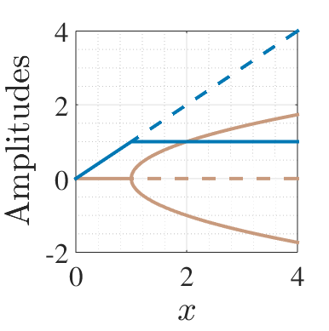
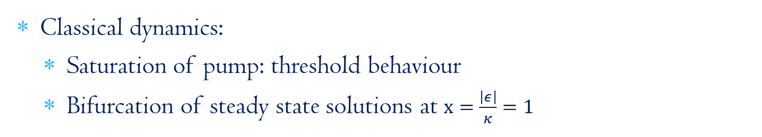
DPA dynamics & squeezing
Classical dynamics:
Saturation of pump: threshold behaviour
Bifurcation of steady state solutions at $x=\frac{\left|ε\right|}{κ}=1$

Slide 4
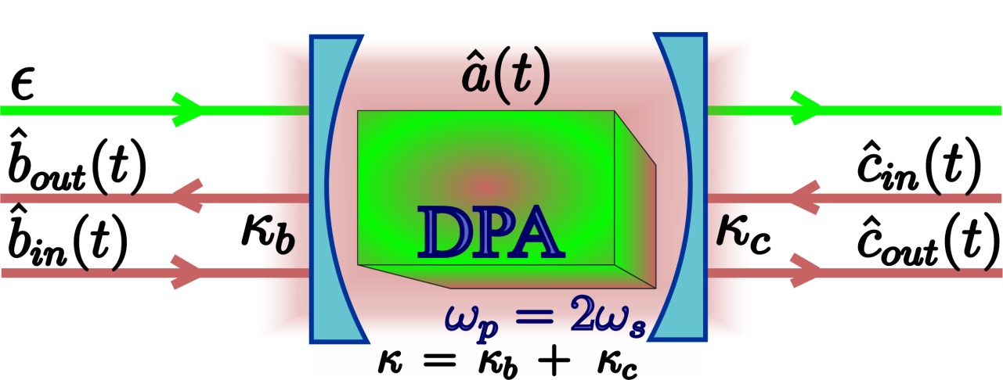
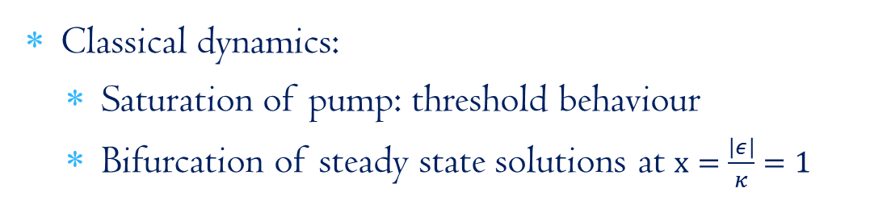
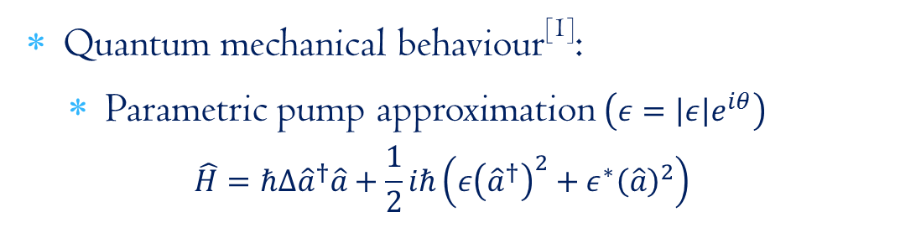
DPA dynamics & squeezing
Classical dynamics:
Saturation of pump: threshold behaviour
Bifurcation of steady state solutions at $x=\frac{\left|ε\right|}{κ}=1$
Quantum mechanical behaviour^{[1]}:
Parametric pump approximation $\left(ε=\left|ε\right|e^{iθ}\right)$
$$\hat{H}=ℏΔ{\hat{a}}^{†}\hat{a}+\frac{1}{2}iℏ\left(ε{\left({\hat{a}}^{†}\right)}^{2}+ε^{∗}{\left(\hat{a}\right)}^{2}\right)$$
^{[1]}PRA, 30:1386 (1984)

Slide 5

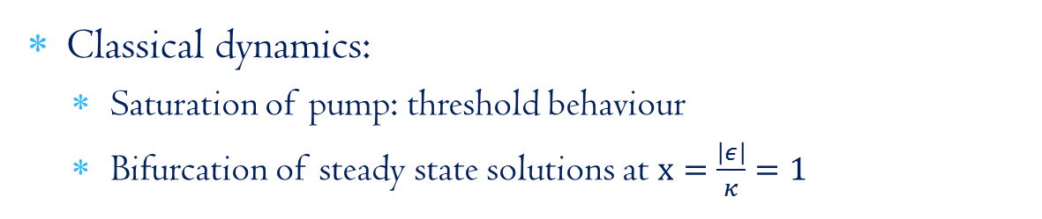
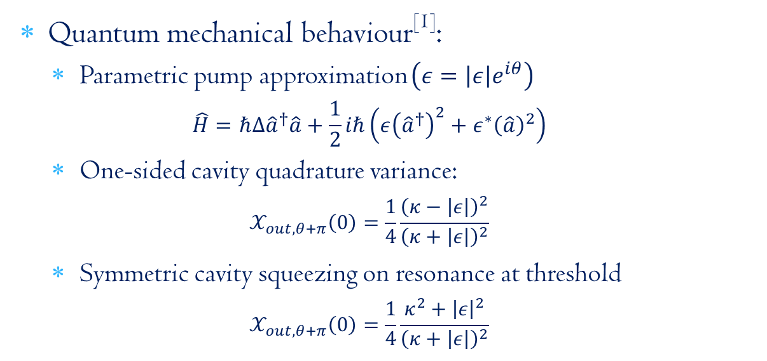
DPA dynamics & squeezing
Classical dynamics:
Saturation of pump: threshold behaviour
Bifurcation of steady state solutions at $x=\frac{\left|ε\right|}{κ}=1$
Quantum mechanical behaviour^{[1]}:
Parametric pump approximation $\left(ε=\left|ε\right|e^{iθ}\right)$
$$\hat{H}=ℏΔ{\hat{a}}^{†}\hat{a}+\frac{1}{2}iℏ\left(ε{\left({\hat{a}}^{†}\right)}^{2}+ε^{∗}{\left(\hat{a}\right)}^{2}\right)$$
One-sided cavity quadrature variance:
$$𝒳_{out,θ+π}\left(0\right)=\frac{1}{4}\frac{{\left(κ−\left|ε\right|\right)}^{2}}{{\left(κ+\left|ε\right|\right)}^{2}}$$
Symmetric cavity squeezing on resonance at threshold
$$𝒳_{out,θ+π}\left(0\right)=\frac{1}{4}\frac{κ^{2}+{\left|ε\right|}^{2}}{{\left(κ+\left|ε\right|\right)}^{2}}$$
^{[1]}PRA, 30:1386 (1984)

Slide 6
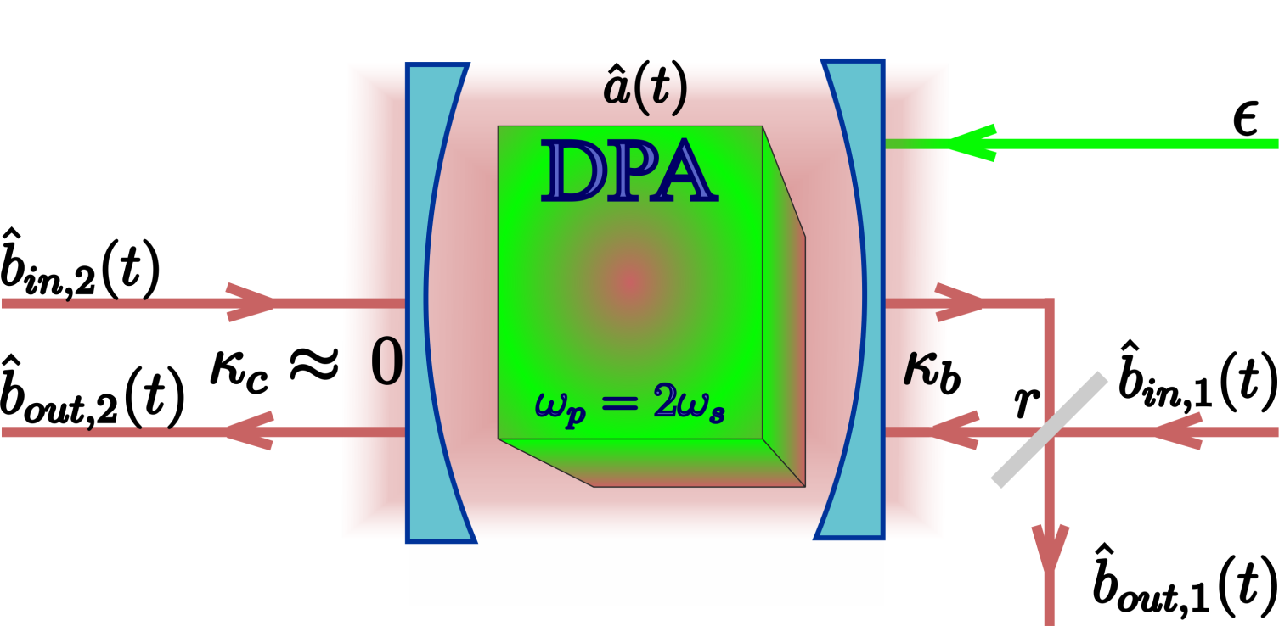
Coherent feedback with DPA
Single DPA
Feedback via beam splitter^{[1]}
^{[1]}PRA, 80:042107 (2009)

Slide 7

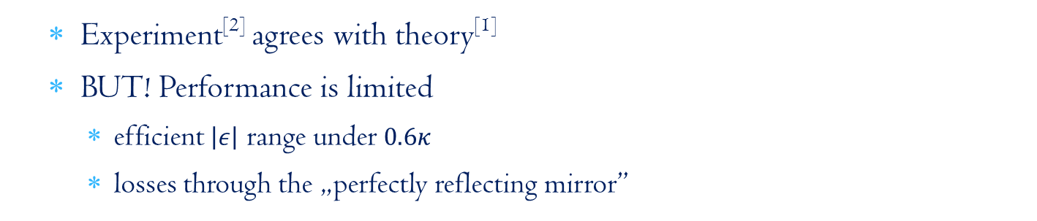
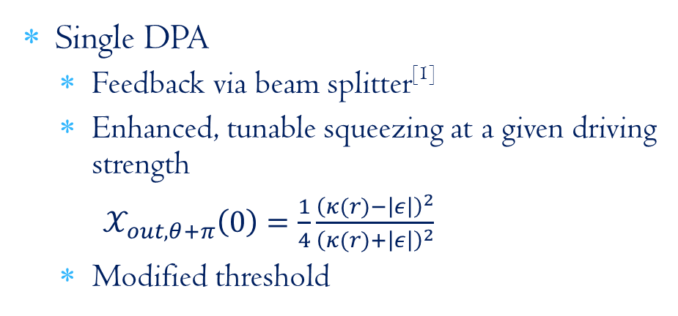
Coherent feedback with DPA
Single DPA
Feedback via beam splitter^{[1]}
Enhanced, tunable squeezing at a given driving strength
$𝒳_{out,θ+π}\left(0\right)=\frac{1}{4}\frac{{\left(κ(r)−\left|ε\right|\right)}^{2}}{{\left(κ(r)+\left|ε\right|\right)}^{2}}$
Modified threshold
Experiment^{[2]} agrees with theory^{[1]}
BUT! Performance is limited
efficient $\left|ε\right|$ range under $0.6κ$
losses through the „perfectly reflecting mirror”
^{[1]}PRA, 80:042107 (2009), ^{[2]}IEEE Trans. Auto. Contr., 57:2045 (2012)

Slide 8
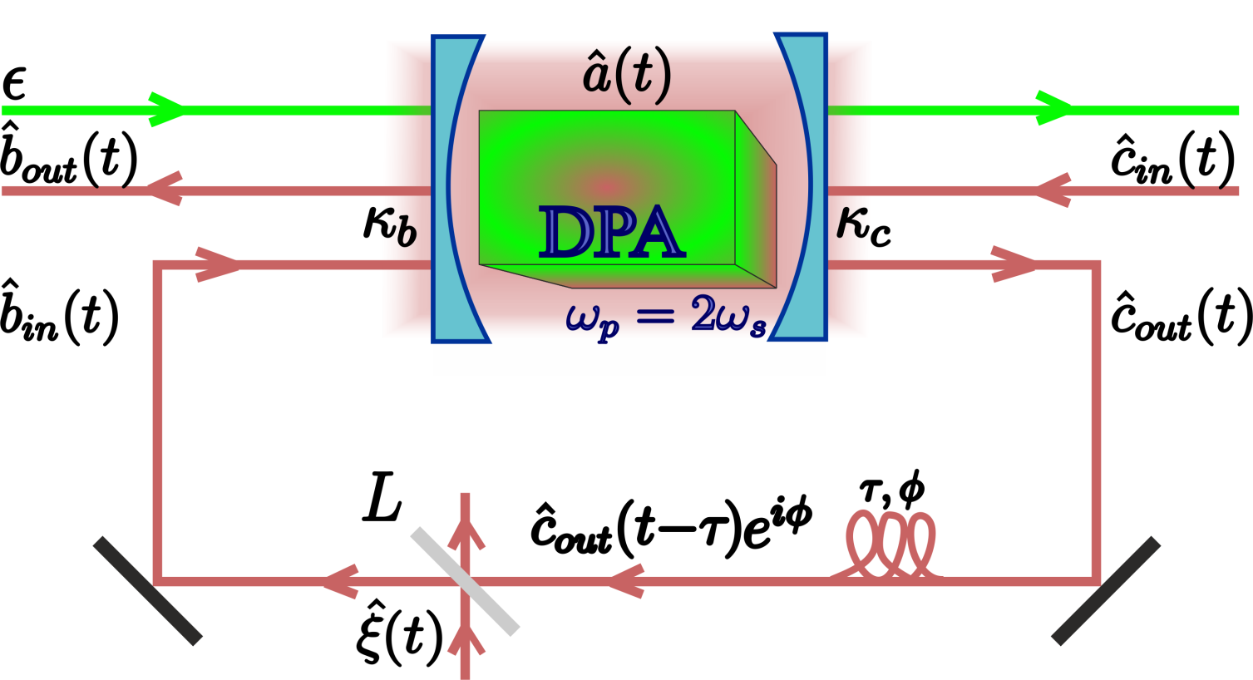
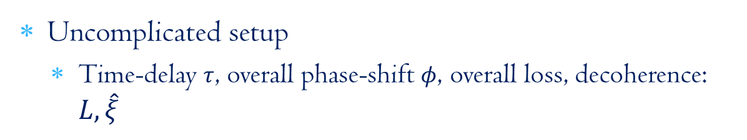
DPA & time-delayed coherent feedback
Uncomplicated setup
Time-delay $τ$, overall phase-shift $φ$, overall loss, decoherence: $L,\hat{ξ}$

Slide 9
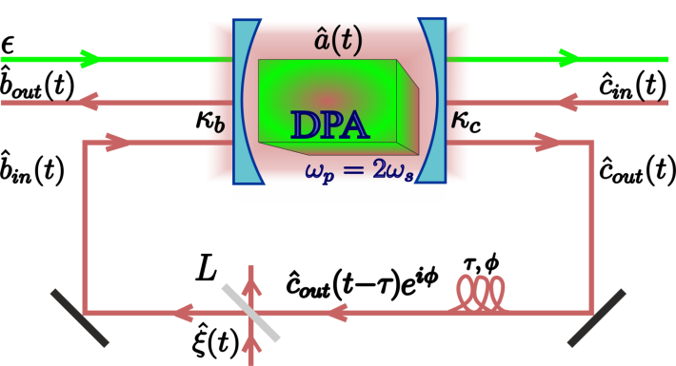

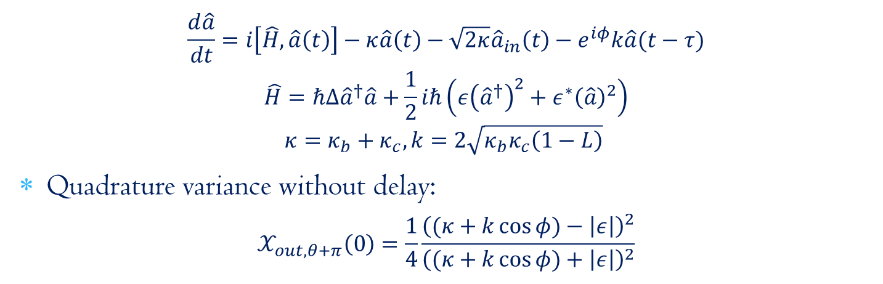
DPA & time-delayed coherent feedback
Uncomplicated setup
Time-delay $τ$, overall phase-shift $φ$, overall loss, decoherence: $L,\hat{ξ}$
Equation of motion of the subharmonic mode:
$$\frac{d\hat{a}}{dt}=i\left[\hat{H},\hat{a}\left(t\right)\right]−κ\hat{a}\left(t\right)−\sqrt{2κ}{\hat{a}}_{in}\left(t\right)−e^{iφ}k\hat{a}(t−τ)$$
$$\hat{H}=ℏΔ{\hat{a}}^{†}\hat{a}+\frac{1}{2}iℏ\left(ε{\left({\hat{a}}^{†}\right)}^{2}+ε^{∗}{\left(\hat{a}\right)}^{2}\right)$$
$$κ=κ_{b}+κ_{c}, k=2\sqrt{κ_{b}κ_{c}\left(1−L\right)}$$
Quadrature variance without delay:
$$𝒳_{out,θ+π}\left(0\right)=\frac{1}{4}\frac{{\left((κ+k\cos{φ})−\left|ε\right|\right)}^{2}}{{\left((κ+k\cos{φ})+\left|ε\right|\right)}^{2}}$$

Slide 10
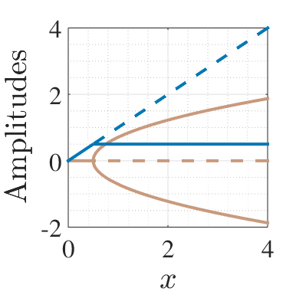
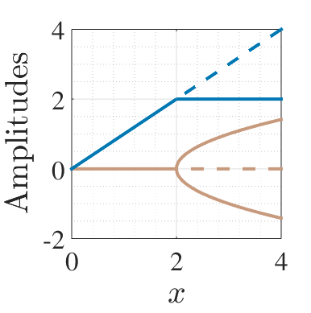




New setup without time-delay
$$k=κ, φ=π$$
$$k=0, φ=0$$
$$k=κ, φ=0$$
Quadrature variance without delay:
$$𝒳_{out,θ+π}\left(0\right)=\frac{1}{4}\frac{{\left((κ+k\cos{φ})−\left|ε\right|\right)}^{2}}{{\left((κ+k\cos{φ})+\left|ε\right|\right)}^{2}}$$

Slide 11
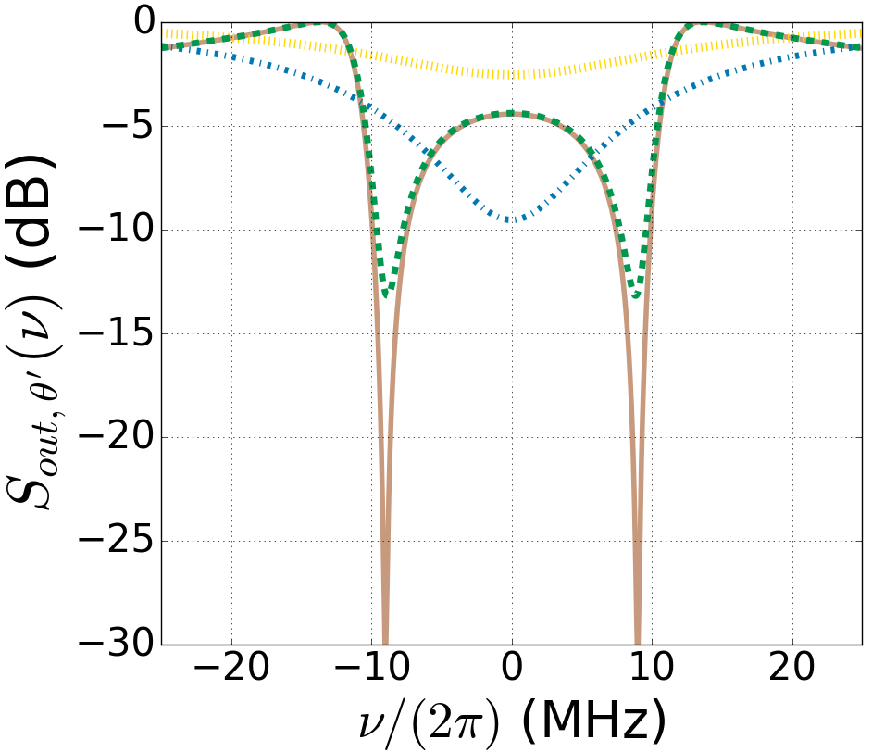
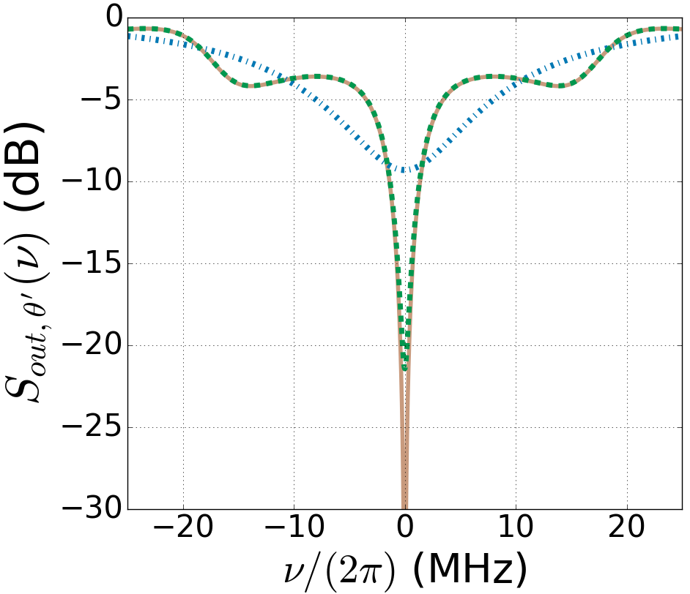




New setup with time-delay
Transcendental equations
Enhanced squeezing with feedback
$φ=0$
$φ=π$
without feedback
symmetric cavity
without feedback
one-sided cavity
with feedback
$$L=5\%$$
with feedback
$$L=0\%$$

Slide 12

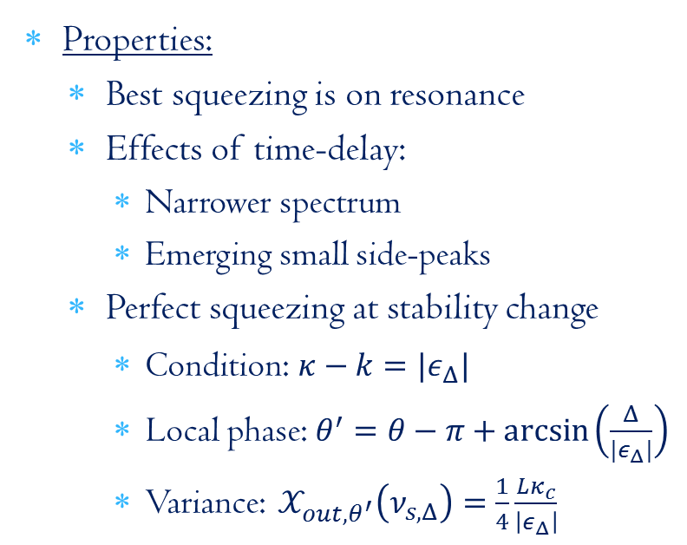
New setup with time-delay
Transcendental equations
Enhanced squeezing with feedback
Properties:
Best squeezing is on resonance
Effects of time-delay:
Narrower spectrum
Emerging small side-peaks
Perfect squeezing at stability change
Condition: $κ−k=|ε_{Δ}|$
Local phase: $θ^{′}=θ−π+\arcsin\left(\frac{Δ}{{|ε}_{Δ}|}\right)$
Variance: $𝒳_{out,θ^{′}}\left(ν_{s,Δ}\right)=\frac{1}{4}\frac{Lκ_{c}}{\left|ε_{Δ}\right|}$
$$φ=π,κ_{b}=0.93κ,\left|ε\right|=0.49κ,$$
$$κτ=3,L=0 \& 5\%$$

Slide 13
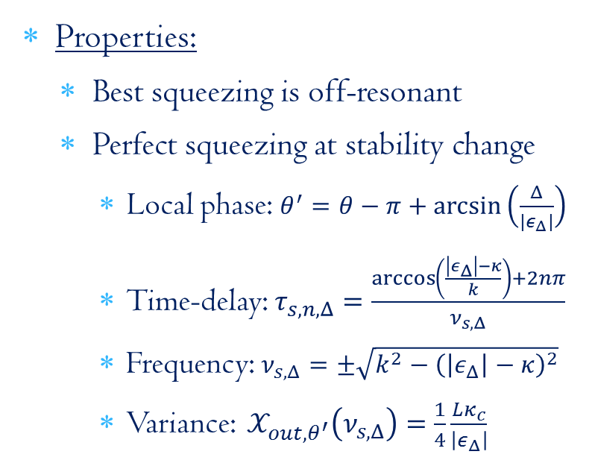

New setup with time-delay
Transcendental equations
Enhanced squeezing with feedback
$$φ=0,κ_{b}=κ_{c}=0.5κ, \left|ε\right|=0.5κ, κτ=2.3,L=0 \& 5\%$$
Properties:
Best squeezing is off-resonant
Perfect squeezing at stability change
Local phase: $θ^{′}=θ−π+\arcsin\left(\frac{Δ}{{|ε}_{Δ}|}\right)$
Time-delay: $τ_{s,n,Δ}=\frac{\arccos\left(\frac{\left|ε_{Δ}\right|−κ}{k}\right)+2nπ}{ν_{s,Δ}}$
Frequency: $ν_{s,Δ}=±\sqrt{k^{2}−{\left(\left|ε_{Δ}\right|−κ\right)}^{2}}$
Variance: $𝒳_{out,θ^{′}}\left(ν_{s,Δ}\right)=\frac{1}{4}\frac{Lκ_{c}}{\left|ε_{Δ}\right|}$

Slide 14
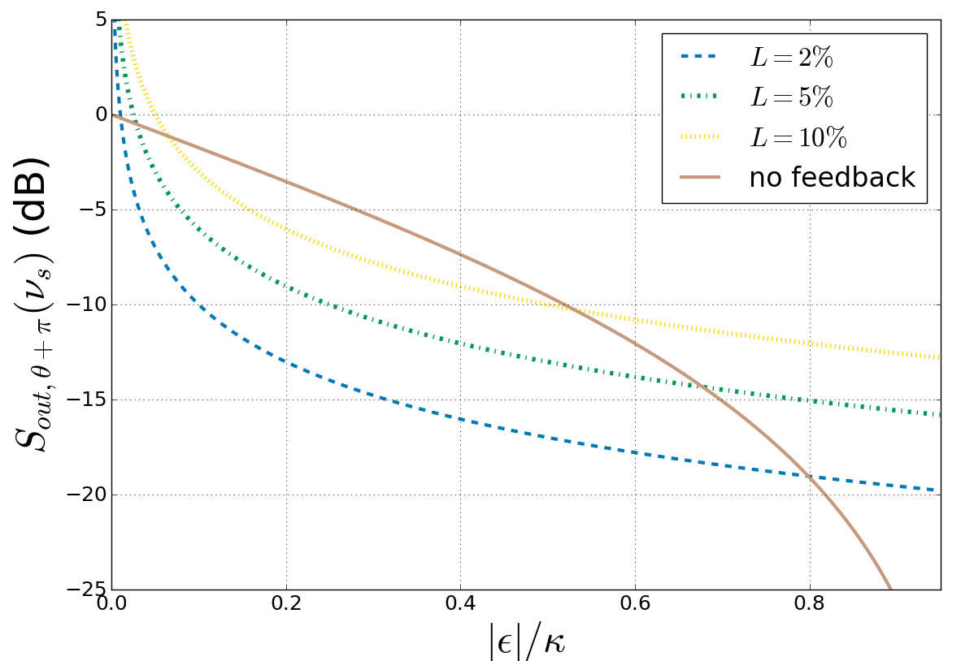
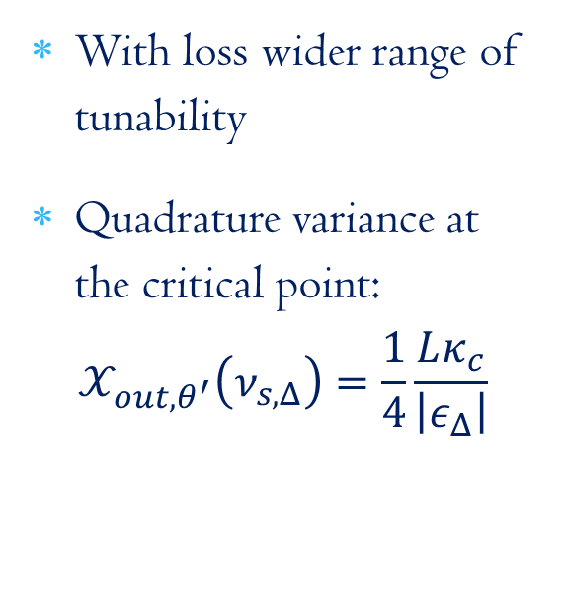
Effects of loss
With loss wider range of tunability
Quadrature variance at the critical point:
$$𝒳_{out,θ^{′}}\left(ν_{s,Δ}\right)=\frac{1}{4}\frac{Lκ_{c}}{\left|ε_{Δ}\right|}$$

Slide 15
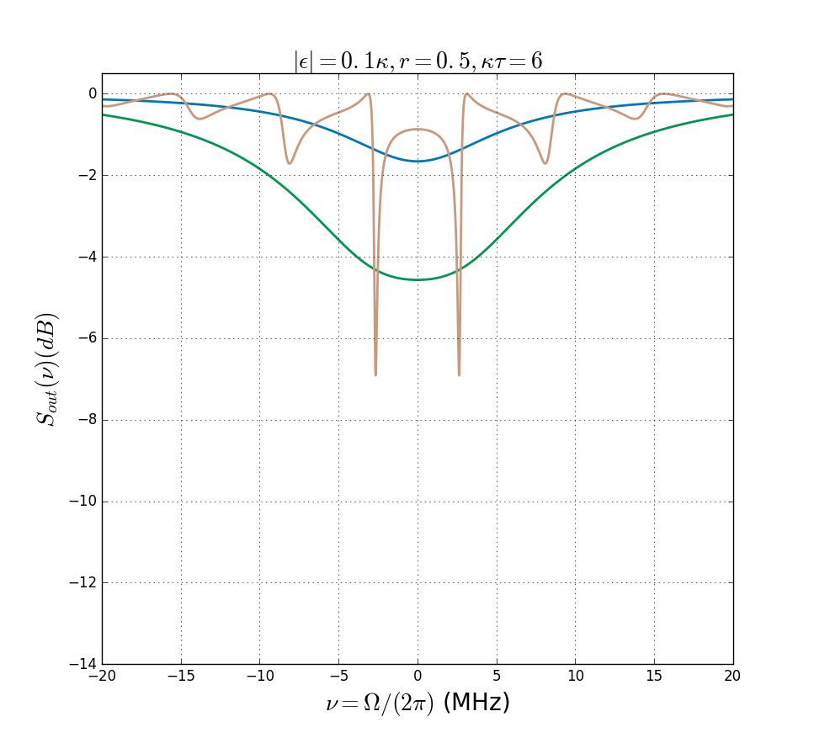
Comparison with previous results^{[1,2]}
with BS
feedback^{[2]}
without
feedback^{[1]}
with delayed feedback
^{[1]}PRA, 30:1386 (1984), ^{[2]}IEEE Trans. Auto. Contr., 57:2045 (2012)

Slide 16
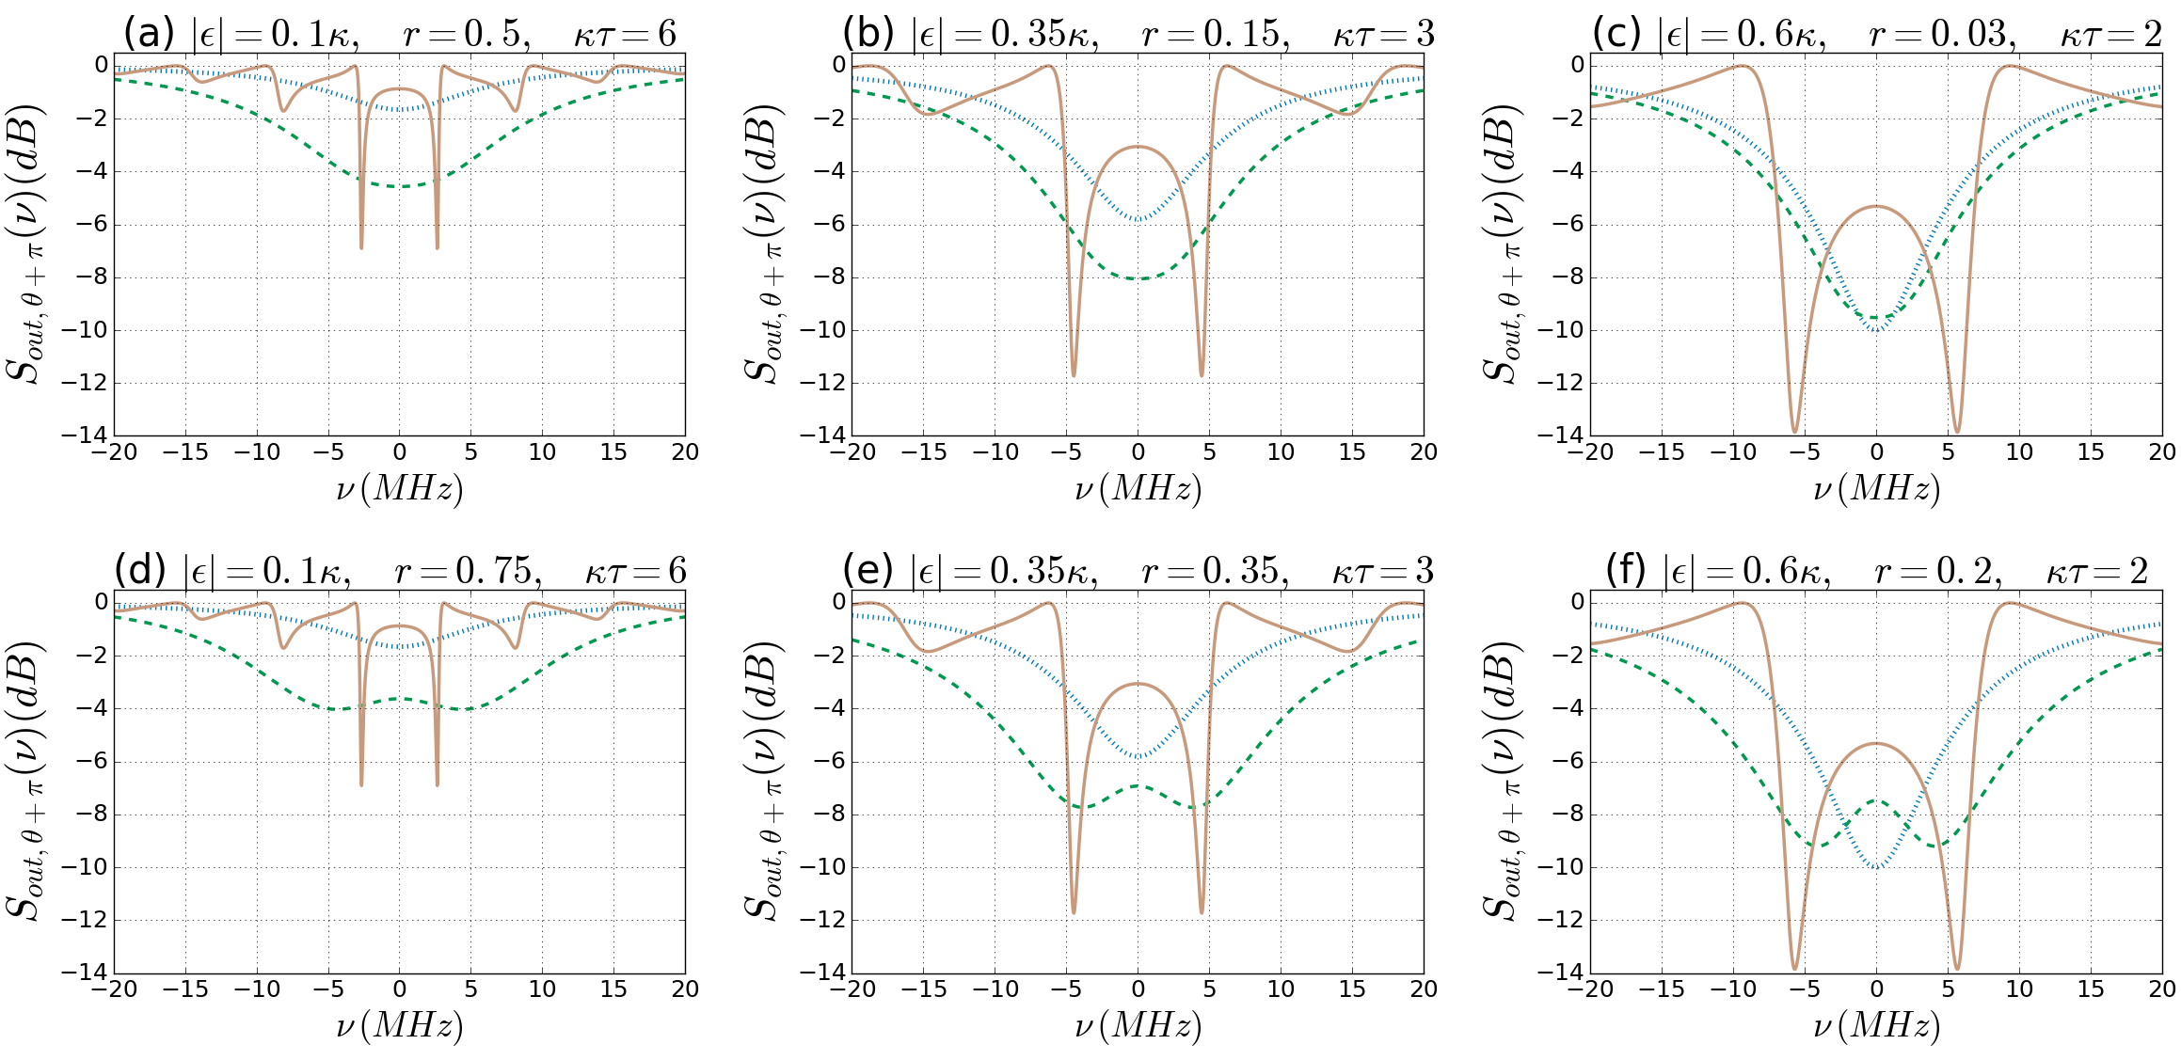
Comparison with previous results^{[1,2]}
with BS
feedback^{[2]}
without
feedback^{[1]}
with delayed feedback
^{[1]}PRA, 30:1386 (1984), ^{[2]}IEEE Trans. Auto. Contr., 57:2045 (2012)

Slide 17

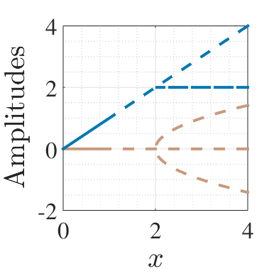
Classical analysis
Originally: pitchfork bifurcation
Time-delay: Changing stability of steady state solutions
Hopf bifurcation

Slide 18
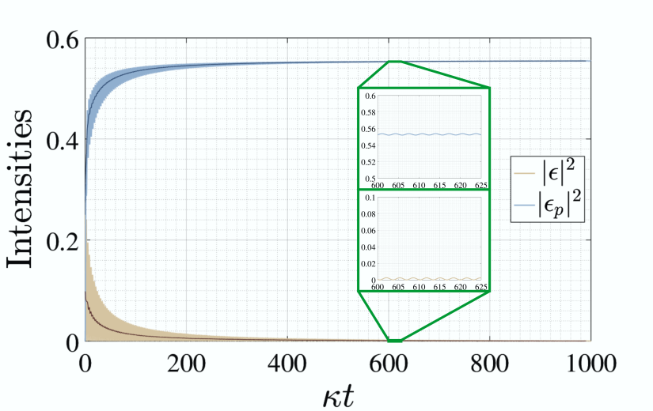
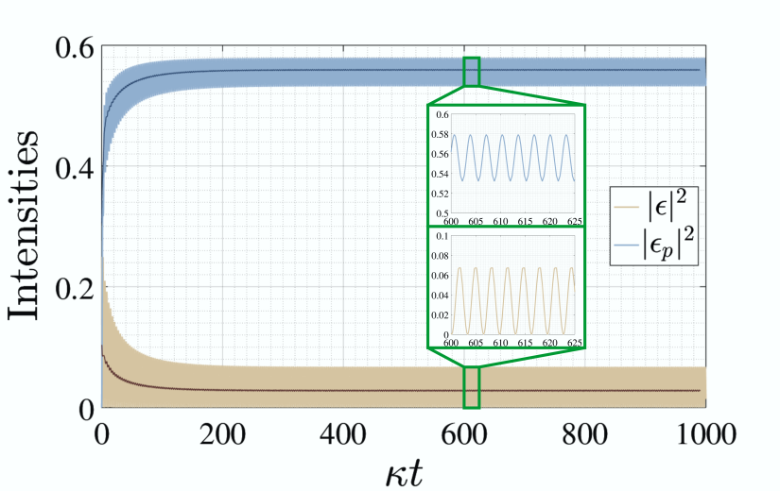
Classical analysis
Originally: pitchfork bifurcation
Time-delay: Changing stability of steady state solutions
Hopf bifurcation
Imaginary eigenvalue becomes the frequency of persistent oscillations

Slide 19
Summary
Coherent feedback:
backaction-free way of enhancing useful quantum mechanical behaviours
Time-delay:
tunable changes in the stability range
Time-delayed one-loop setup with a DPA: enhanced squeezing
Improvement compared to previous feedback setups
On and off-resonant squeezing as well
Result of the changing dynamics of the system
Loss in the feedback loop:
Decreased squeezing
BUT! higher tunability

Slide 20
Thank you for Your
attention!

Slide 21
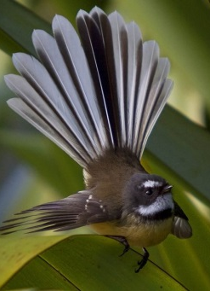
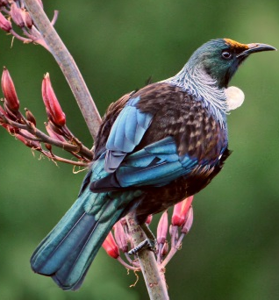
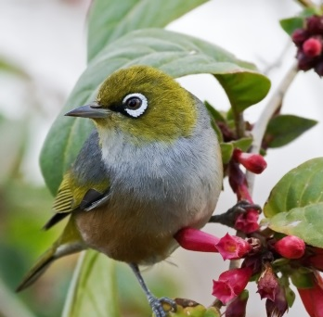
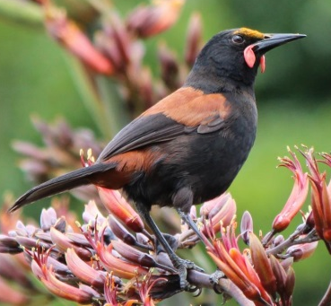
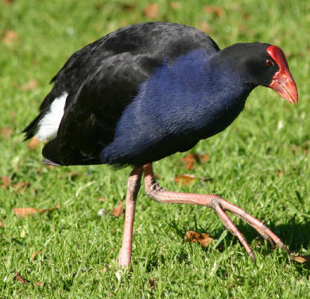
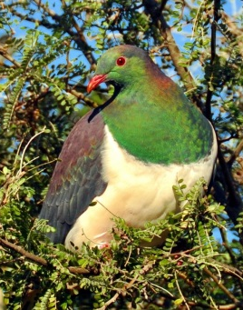
Thank you for Your
1
2
3
4
5
6
7
8
9
10
11
12
13
14
15
16
17
attention!

Slide 22
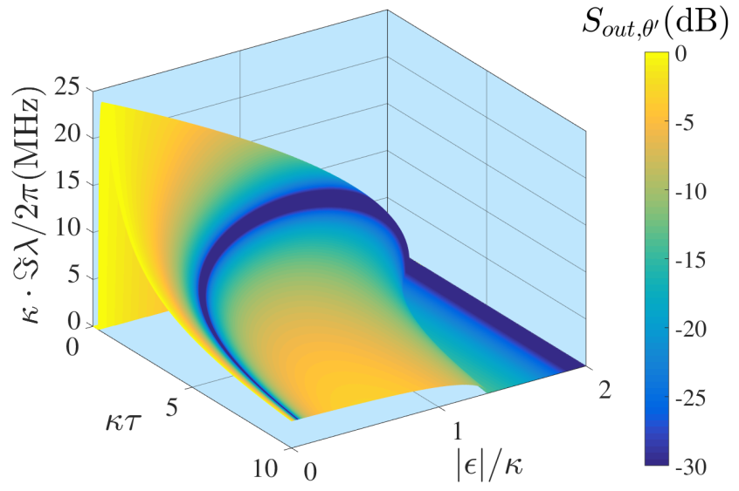
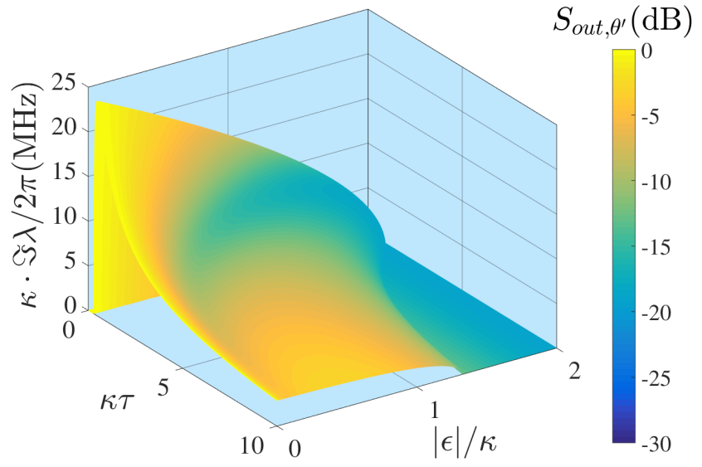
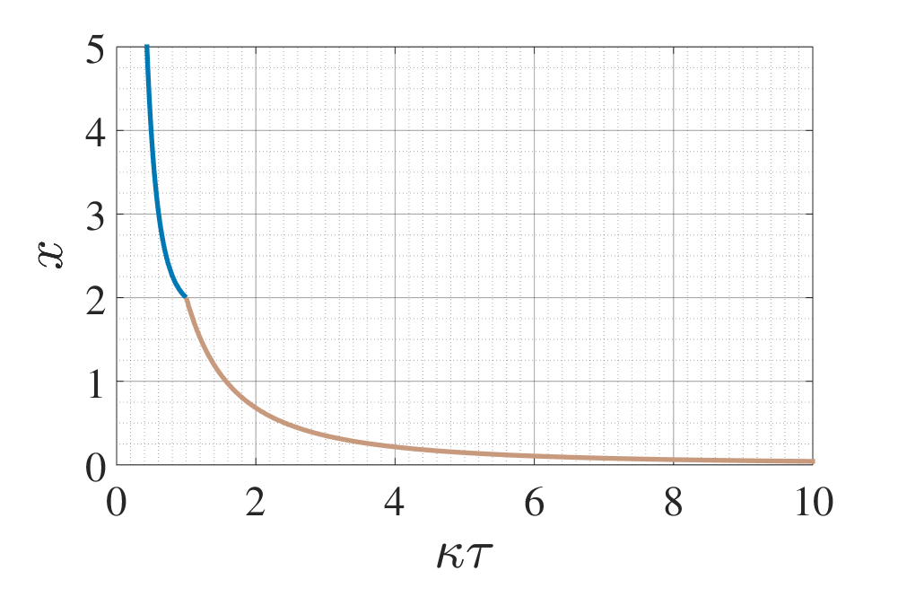
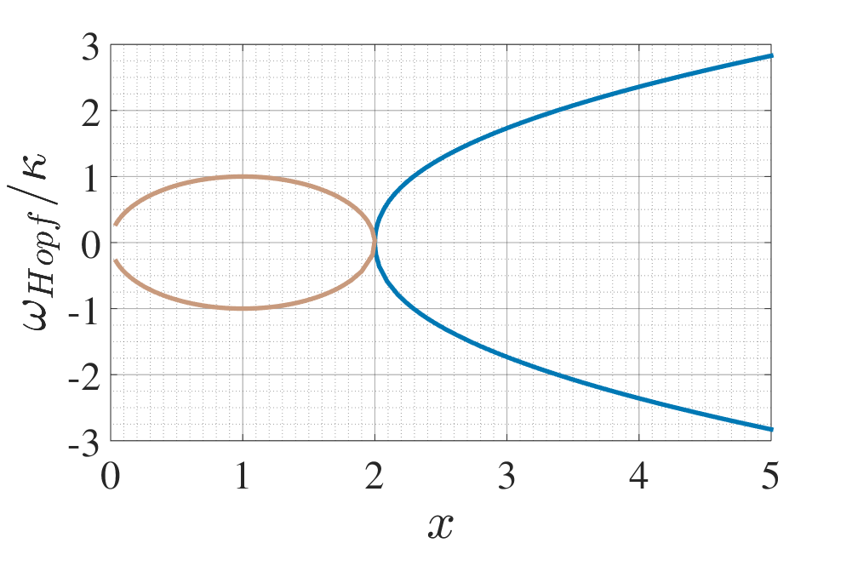
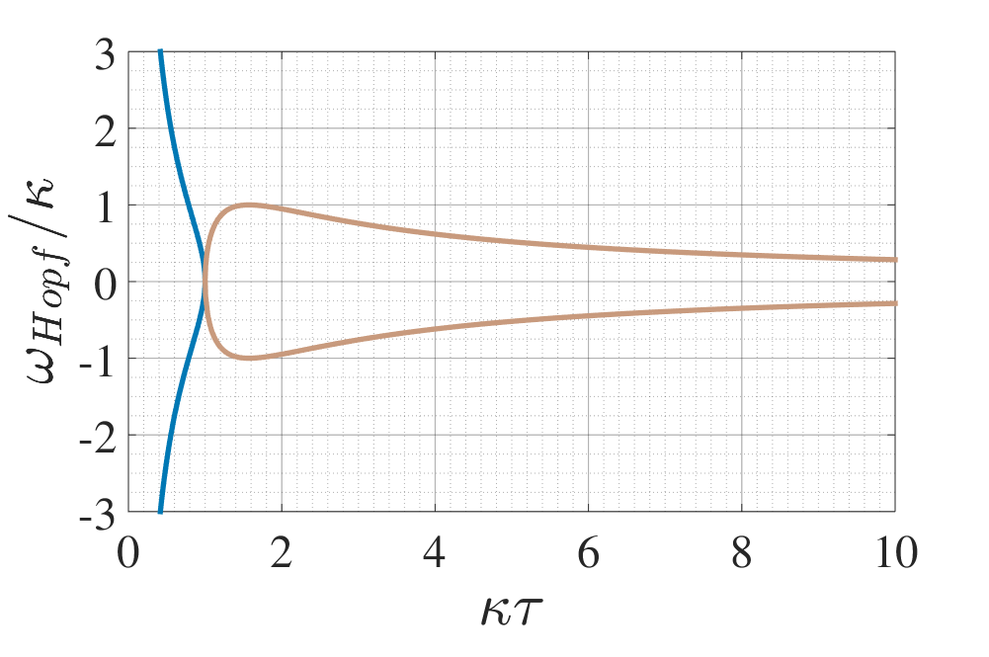
Characteristic frequency range
$$0≤ν_{s}≤\sqrt{\left|ε\right|\left(2κ−\left|ε\right|\right)},0≤\left|ε\right|≤\left|κ+ke^{iφ}\right|$$

Slide 23
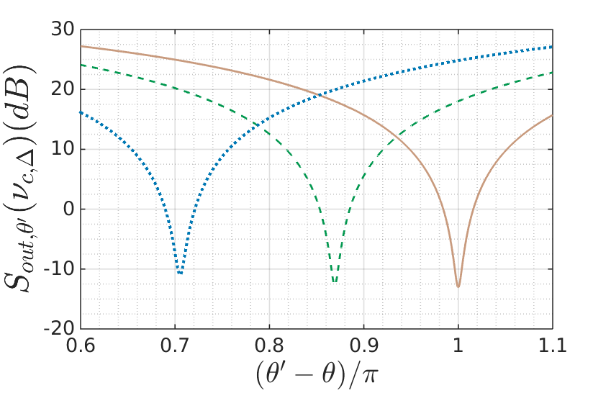
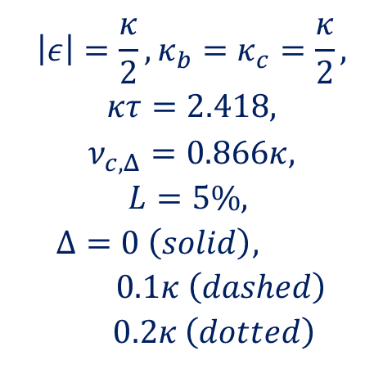

Detuning and quadrature angle
Local oscillator phase:
$$θ^{′}=θ−π+\arcsin\left(\frac{Δ}{{|ε}_{Δ}|}\right)$$
$$\left|ε\right|=\frac{κ}{2},κ_{b}=κ_{c}=\frac{κ}{2},$$
$$κτ=2.418,$$
$$ν_{c,Δ}=0.866κ,$$
$$L=5\%,$$
$$Δ=0 \left(solid\right), 0.1κ \left(dashed\right)$$
$$0.2κ \left(dotted\right)$$

Slide 24
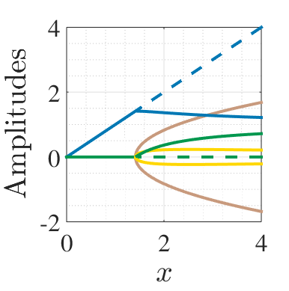
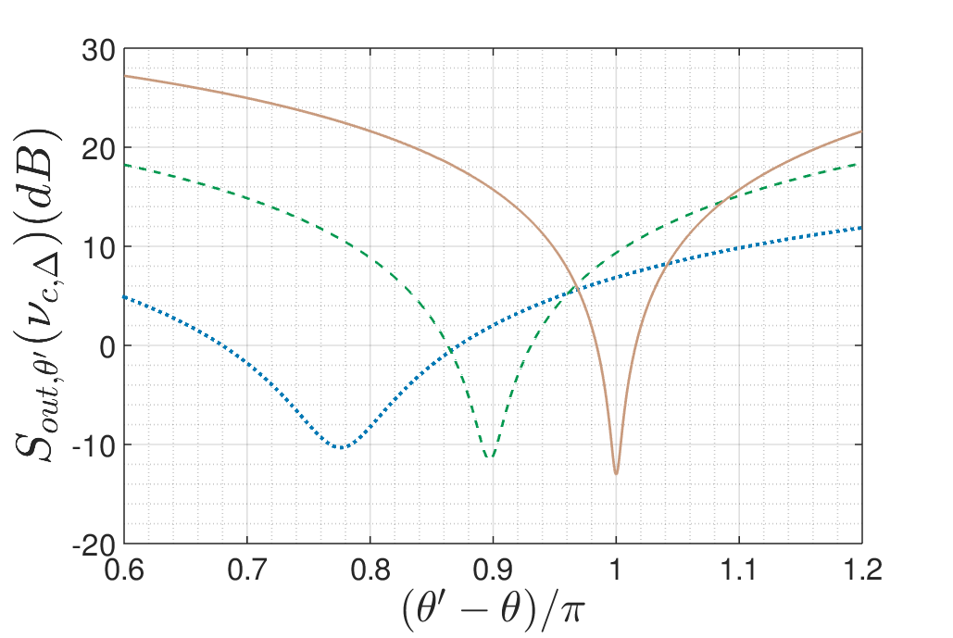
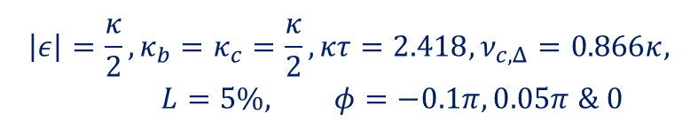
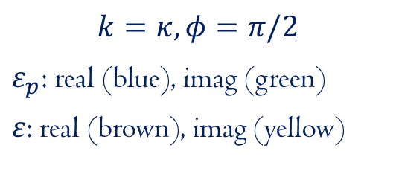
Effects of the phase shift
$$\left|ε\right|=\frac{κ}{2},κ_{b}=κ_{c}=\frac{κ}{2}, κτ=2.418,ν_{c,Δ}=0.866κ, L=5\%, φ=−0.1π, 0.05π \& 0$$
$$k=κ, φ=π/2$$
$ε_{p}$: real (blue), imag (green)
$ε$: real (brown), imag (yellow)

Slide 25



Pyragas-type feedback^{[1,2]}
Classical: Stabilizing unstable periodic orbitals
Reordering of the equation of motion with $φ=π$:
$$\frac{d\hat{a}}{dt}=i\left[\hat{H},\hat{a}\left(t\right)\right]−\left(κ−k\right)\hat{a}\left(t\right)−\sqrt{2κ}{\hat{a}}_{in}\left(t\right)+k\left(\hat{a}\left(t−τ\right)−\hat{a}\left(t\right)\right)$$
^{[1]}PLA, 170:421 (1992), ^{[2]}NJP 16:065004 (2014),

Slide 26



Gravitational waves
Adding $π$ to the local oscillator phase in our case gives the required characteristics
Frequency of the best squeezing: changing with the local oscillator phase
Lower frequencies: around $θ^{′}−θ=0$
Higher frequencies: around $θ^{′}−θ=π$
^{[1]}PLA, 170:421 (1992), ^{[2]}NJP 16:065004 (2014),

Slide 27
More previous studies
Plant and controller system
Controller: two-mode squeezer
Int. J. Cont. 85:1865 (2012)
2 OPOs coupled in a feedback loop with a phase difference
Opt. Express 21:1 (2013)
Trapped modes in a linear system
arXiv: 1510.08942
Delayed feedback for discreet quantum information
PRL, 110:1 (2013)
PRA, 91:052321 (2015)

